Slide 1
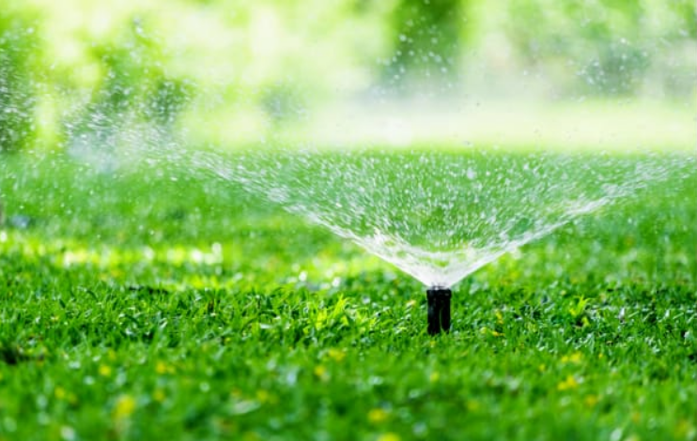

AUTOMATIC PLANT IRRIGATION SYSTEM
PRESENTED BY
SUNDARAVALLI S -111620106102
SOWMYA B-111620106096
RMK COLLEGE OF ENGINEERING AND TECHNOLOGY

Slide 2
contents
Objective
Block diagram
Components required
Circuit diagram
Advantages
Application
Working video of automatic plant irrigation system
Conclusion

Slide 3
OBJECTIVE
TO develop an automatic plant irrigation system using Arduino UNO.

Slide 4
BLOCK DIAGRAM
POWER SUPPLY 9V DC
CAPACITIVE MOISTURE SENSOR
ARDUINO UNO
RELAY
WATER PUMP WITH MOTOR
SOIL

Slide 5
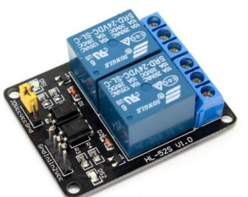
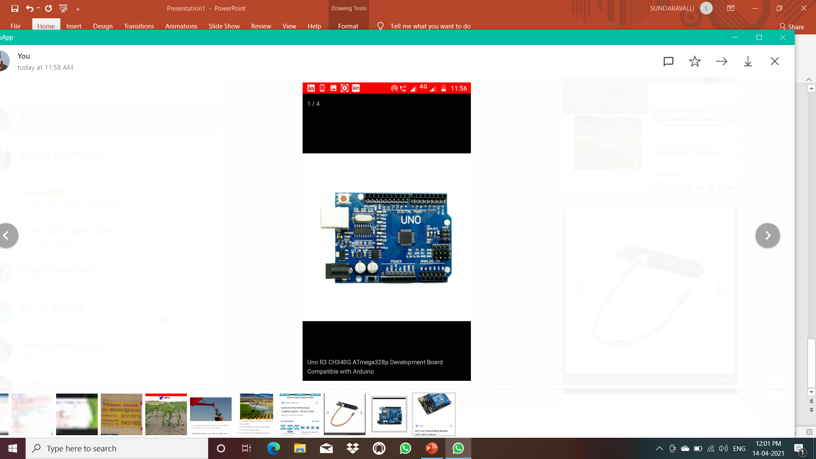
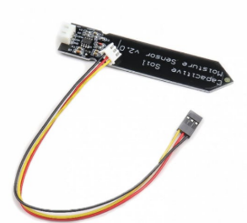
COMPONENTS REQUIRED:
ARDUINO UNO
CAPACITIVE SOIL MOISTURE SENSOR
5V RELAY MODULE
WATER PUMP MOTOR
MALE AND FEMALE JUMPER WIRES
USB
BATTERY
PLASTIC TUBE

Slide 6
Advantages of USING capacitive soil moisture sensor over RESISTIVE soil moisture sensor :
QUICK AND ACCURATE RESOPNSE
ABILITY TO READ SOIL VOLUMETRIC WATER CONTENT DIRECTLY
NO SPECIAL MAINTANANCE IS REQUIRED
CORROSION RESISTANT
LARGE RANGE OF OPERATING ENVIRONMENT(0 TO 50 DEGREE CELSIUS) AND RANGE OF MEASUREMENT( 0% TO SATURATED WATER CONTENT)

Slide 7
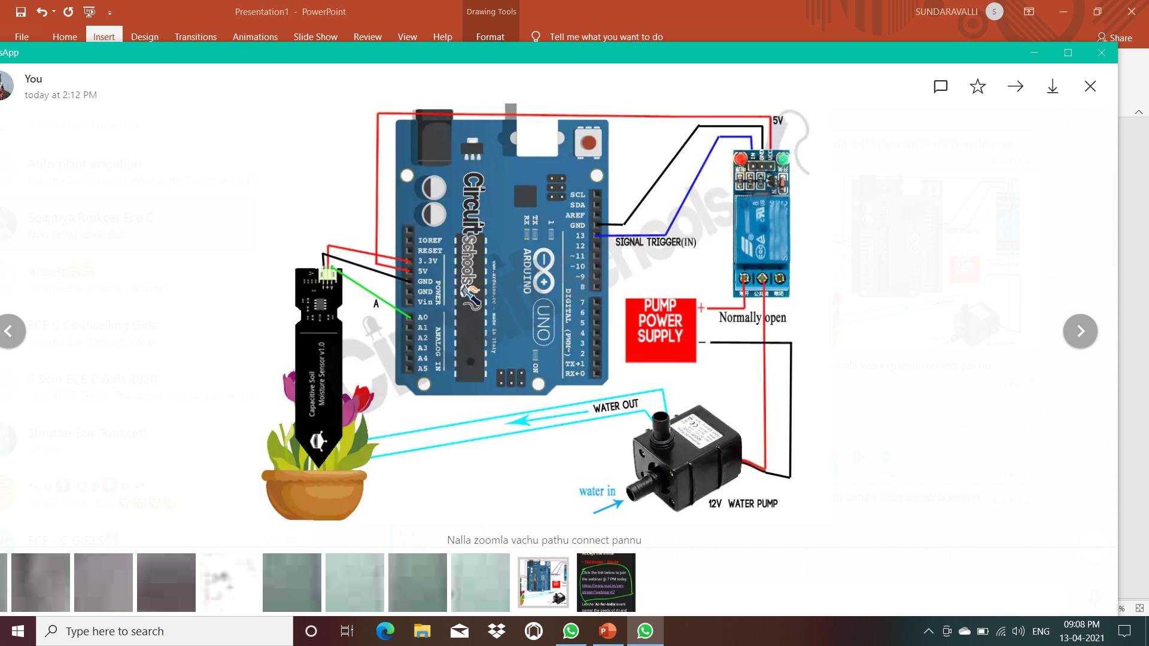
CIRCUIT DIAGRAM:

Slide 8
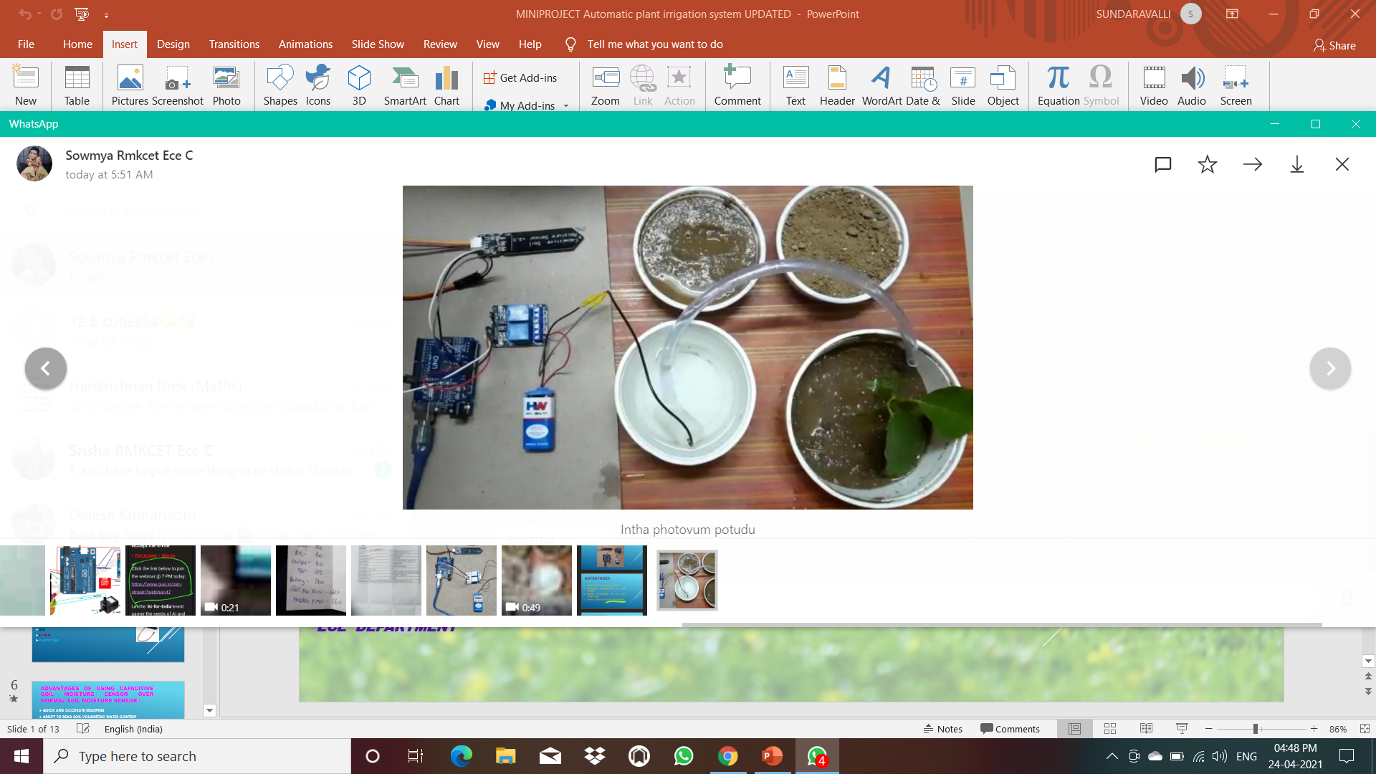
Circuit:

Slide 9
Advantages:
LOW COST AND RELIABLE CIRCUIT
COMPLETE ELIMINATION OF MAN POWER
WORKS ACCORDING TO THE SOIL CONDITION
HIGHLY SENSITIVE TO MOISTURE

Slide 10
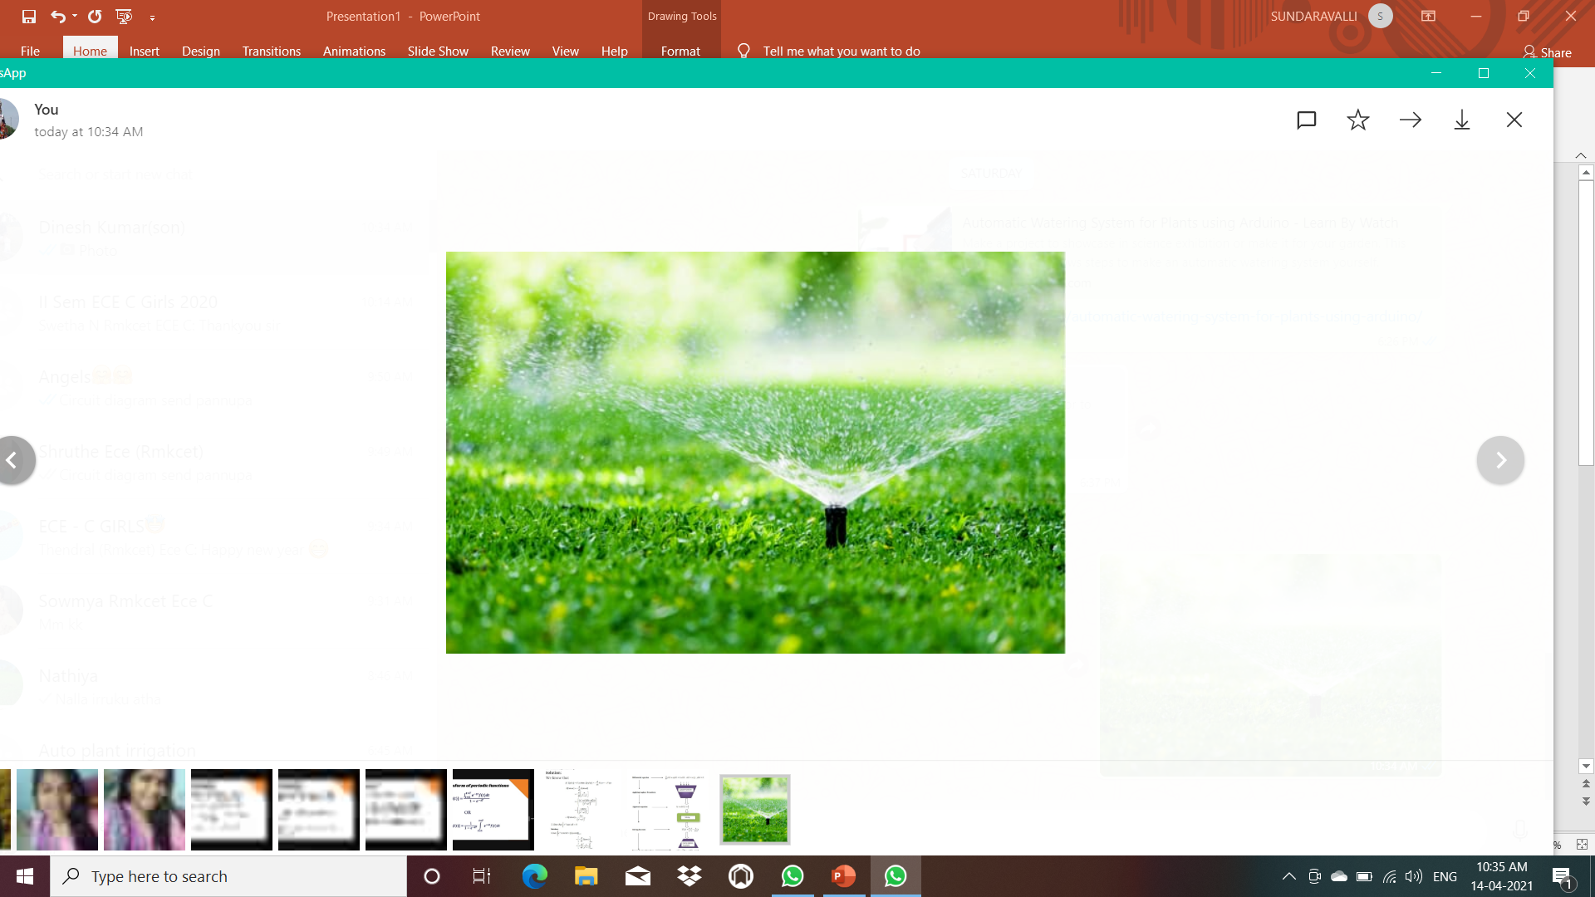
APPLICATIONS:
ROOF GARDENS
LAWNS
AGRICULTURE

Slide 11
COST OF THE PROJECT:
ARDUINO BOARD- Rs.400
WATER PUMP MOTOR- Rs.160
5V RELAY MODULE- Rs.160
USB- Rs. 60
JUMPER WIRES- Rs. 60
9V BATTERY Rs. 25
CAPACITIVE SOIL MOISTURE SENSOR- Rs.220
TOTAL
Rs.1085

Slide 12
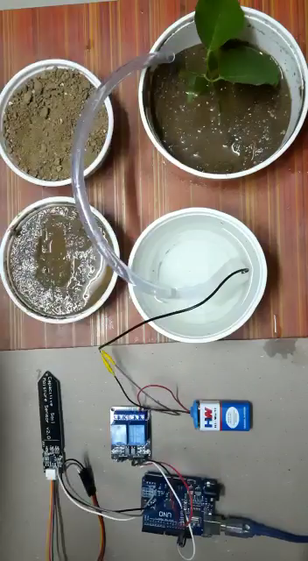

Slide 13
CONCLUSION:
Thus the automatic plant irrigation system using arduino is made and worked successfully.
This project focuses on the cost effective automatic plant irrigation system which allows saving water and human efforts with desired quantity.

Slide 14
THANK YOU

